Slide 1


Sketch-based Querying of Distributed Sliding-window Data Streams
Odysseas Papapetrou, Minos Garofalakis, Antonios Deligiannakis
SoftNet laboratory, Technical University of Crete, Greece

Slide 2
Streams and sliding windows
Querying of distributed sliding-window data streams
Distributed: Many nodes/peers, many streams, aggregate statistics
Cannot afford to centralize all data
Sliding windows: Only interested on recent data
Arrival-based model: Account for the last X items
Time-based model: Account for the items arriving in the last X minutes
Data streams: High-dimensional
Maintain occurrences of ip addresses
Maintain term frequencies in textual streams (e.g., emails)
Small space/time

Slide 3
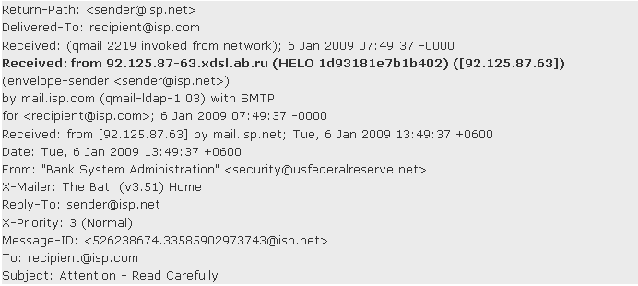

Motivation example: Monitoring network packet traffic
Monitor the distribution of packet traffic over IP addresses
Challenge 1:
Local statistics: Compactly/efficiently maintain the ip address frequencies
Sliding window → use only recent packets, e.g., of last hour
Queries with multiple sliding window lengths!
Challenge 2:
How to aggregate local statistics to get the global statistics
Global statistics
ip | freq.
10.0.3.4 | 121
11.2.1.5 | 92
20.3.5.6 | 281
145.4.5.3 | 92
… | …
n_{j}
…
n₄
n₈
n₁
n₂
n₃
n₅
n₆
n₇
Local statistics
ip | freq.
10.0.3.4 | 12
20.3.5.6 | 120
111.1.2.3 | 2
121.2.1.1 | 11
145.4.5.3 | 18
… | …

Slide 4
Solution desiderata
Need a method/data structure to maintain the (local) stream statistics:
Ability to handle sliding windows of abritrary length
Fast
Up to 10 million network packets per second
Small memory footprint
Routers: MB of memory
Network-efficient
Local statistics exchanged over the network
Composable
Aggregating of local statistics to derive global statistics
Our direction
Trade off statistics accuracy for efficiency (memory, network)
Sketches: Lossy summarizations of data streams

Slide 5
Count-min sketches [Cormode, Muthukrishnan‘05]
Generic sketch for maintaining frequencies, frequency moments, etc...
An array of w x d counters
Each row i associated with a hash function h_{i} with range [1, w]
w counters
0 | 0 | 0 | 0 | 0 | 0 | 0 | 0 | 0 | 0
0 | 0 | 0 | 0 | 0 | 0 | 0 | 0 | 0 | 0
0 | 0 | 0 | 0 | 0 | 0 | 0 | 0 | 0 | 0
0 | 0 | 0 | 0 | 0 | 0 | 0 | 0 | 0 | 0
0 | 0 | 0 | 0 | 0 | 0 | 0 | 0 | 0 | 0
0 | 0 | 0 | 0 | 0 | 0 | 0 | 0 | 0 | 0
0 | 0 | 0 | 0 | 0 | 0 | 0 | 0 | 0 | 0
0 | 0 | 0 | 0 | 0 | 0 | 0 | 0 | 0 | 0
+1
+1
Add x
+1
h₁(x) = 7
h₂(x) = 1
h₃(x) = 4
h₄(x) = 6
+1
d hash functions
+1
STREAM
Example: x, y, z, … can correspond to ip addresses
+1
x, 10z, y, x, 20y, 3k …
+1
+1

Slide 6
Count-min sketches
Estimating the frequency (point queries)
overestimate due to hashing collisions
Error relative to the stream size
Also enables inner join and self join queries!
w counters
23 | 17 | 22 | 32 | 13 | 11 | 44 | 45 | 52 | 15
11 | 78 | 43 | 74 | 9 | 63 | 8 | 2 | 53 | 56
56 | 23 | 93 | 12 | 6 | 46 | 34 | 44 | 23 | 33
62 | 44 | 9 | 55 | 84 | 12 | 77 | 23 | 54 | 62
7 | 8 | 46 | 11 | 82 | 73 | 64 | 45 | 22 | 53
73 | 52 | 23 | 74 | 35 | 93 | 41 | 7 | 32 | 14
22 | 23 | 20 | 10 | 51 | 21 | 5 | 11 | 32 | 35
35 | 10 | 16 | 55 | 22 | 50 | 59 | 44 | 22 | 52
Example: Query x:
d hash functions

Slide 7
Sliding windows
But…
Sketches do not support sliding windows
Several sliding window structures proposed
Exponential histograms, deterministic waves, randomized waves, ...
Only simple statistics, e.g., count the number of one-bits over sliding windows
This work:
Combine count-min sketches with sliding window structures
Window to monitor
Stream
100101101110101010111……..….0101101010101010
Time

Slide 8

Exponential histograms [Datar et al.‘02]
Exponential histograms (and deterministic waves)
Key idea
break the sliding window range in non-overlapping buckets of exponentially increasing sizes
use these buckets for maintaining and estimating the aggregates
E.g.,
time 1 - 27: 8 one-bits arrived
time 27 – 35: 4 one-bits, …
Query execution: sum only the buckets in the query range, and half of the weight of the last bucket
b₁ | b₂ | b₃ | b₄ | b₅
8 | 4 | 2 | 1 | 1
Time: 1 27 35 42 47 51
Bucket information
Ending time
Number of one-bits
Required memory:

Slide 9
ECM-sketches
Two distinct functionalities
Sketches: Summarize distributions, no sliding window functionality
Sliding window data structures: only simple statistics
Our contributions
ECM-sketches
Combines count-min sketches with sliding windows
Compact data stream summaries over sliding windows
Probabilistic guarantees for frequency, self join/inner product queries

Slide 10
ECM-sketches
w counters
Counters are sliding windows
Exponential histograms
Deterministic waves
Randomized waves
...
Updated and queried as with standard count-min sketches
d hash functions
b₁ | b₂ | b₃ | b₄ | b₅
8 | 4 | 2 | 1 | 1
Time: 1 27 35 42 47 51

Slide 11

ECM-sketches
Combine count-min sketches with sliding windows
Example: STREAM: (t₁,z), (t₃, 6x), (t₅, y), ...
Error coming from both hash collisions and the sliding window counters estimation
Desired ε → the algorithm chooses the optimal configuration (d, w, sliding window)
Total size depends on the sliding window structure (detailed analysis in the paper)
Challenge 1: Maintaining of data stream statistics over sliding windows
t₁,+1
t₁,+1
Add (t₁,z)
t₁,+1
h₁(z) = 5
h₂(z) = 2
h₃(z) = 8
h₄(z) = 6
t₁,+1
d hash functions
t₁,+1
Query (t₂,z)
t₁,+1
t₁,+1
w counters

Slide 12
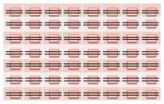
Aggregating ECM-sketches
Order-preserving aggregation
Stream 1: (1, A), (2, B), (10, C), (11, A), (17, D), (18, B), …
Stream 2: (3, B), (6, A), (13, A), (14, A), (22, D), (27, B), …
Aggregate: (1, A), (2, B), (3, B), (6, A), (10, C), (11, A), (13, A), (14, A), …
Composition of ECM-sketches: compose the corresponding counters
Requires composition of sliding windows!
Randomized sliding window structures
Trivial lossless aggregation, very expensive (computation, memory, network)
Deterministic sliding window structures
More compact and efficient, do not trivially support aggregation
…
n_{j}
…
n₄
n₈
h
+
…
n₁
n₂
n₃
n₅
n₆
n₇
+
+

Slide 13
Aggregation for deterministic sliding window structures
Key idea: Use the sliding window buckets as logs to ‘re-play the streams’
E.g.
Generate an aggregate exponential histogram as follows:
For each bucket of size b, generate two events:
b/2 one-bits arrive at the starting time of the bucket
b/2 one-bits arrive at the ending time of the bucket
Sort events based on time
Construct a new exponential histogram with these events
If each of the EH has error ε, then the aggregated EH has error ≈2ε (worst-case analytic prediction -- tight)
Proof in the paper
Result holds for any number of exponential histograms composed
b₁ | b₂ | b₃ | b₄ | b₅
8 | 4 | 2 | 1 | 1
b₁ | b₂ | b₃ | b₄ | b₅
8 | 4 | 2 | 1 | 1
Time: 1 27 35 42 47 51
1 12 22 28 31 33

Slide 14

Aggregating ECM-sketches
Given A, B, ....
Aggregated sketch represents the order-preserving aggregation of all streams
Challenge 2: Aggregation of local statistics to get global statistics
E
…
C
+
D
h
…
A
+
B
A
B
C
 |  |  | …
 |  |  | …
 |  |  | …
 |  |  | …
… | … | … | …
 |  |  | …
 |  |  | …
 |  |  | …
 |  |  | …
… | … | … | …
 |  |  | …
 |  |  | …
 |  |  | …
 |  |  | …
… | … | … | …
+
=

Slide 15
Experimental evaluation
ECM-sketches based on
Exponential histograms, deterministic waves, randomized waves
ε in [0.05 , 0.25]
Centralized setting: Evaluate individual ECM-sketches
Distributed setting: Nodes organized in a binary tree, aggregated ECM-sketches
Dataset:
World-cup ’98: approx. 1.1 billion http requests (key:url)
Queries: Point queries (URL frequency), and self-join queries
Observed error relative to the stream size, as in conventional Count-min sketches.
Sliding window of 1 million seconds (~11.5 days)
More results in the paper

Slide 16
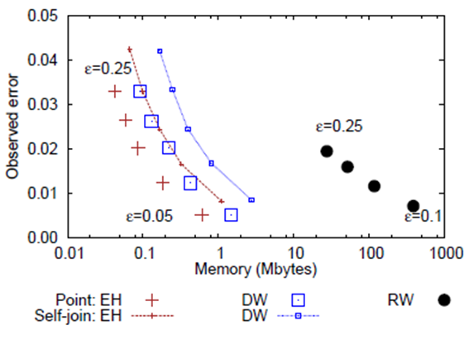
Estimation accuracy of ECM-sketches
ECM-sketches with exponential histograms
More efficient and more compact than deterministic waves
At least two orders of magnitude smaller compared to randomized waves

Slide 17
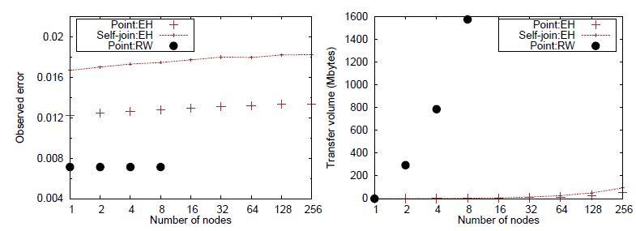
Accuracy of aggregated ECM-sketches
ECM-sketches with randomized waves: Error-free aggregation, high space complexity
ECM-sketches based on deterministic sliding windows: error smaller than the worst-case analytic prediction

Slide 18
Conclusions
ECM-sketches
The first data structure to enable sliding window statistics over high-dimensional streams
Enables composition with controllable error bounds
Future work
ECM-sketches to continuously monitor functions over distributed data
Geometric method [Sharfman‘06]

Slide 19
Thank you for your attention…
http://www.softnet.tuc.gr
http://www.lift-eu.org

