Slide 1


Continuous Fragmented Skylines over Distributed Streams
Odysseas Papapetrou and Minos Garofalakis
SoftNet laboratory, Technical University of Crete

Slide 2
New requirements for skylines
Distributed and P2P algorithms, tracking of skylines, etc.
Continuous monitoring of functional skylines with data fragmentation
  Volatile data: sensor networks, network monitoring, financial streams
    Skyline tracking essential
  Data points fragmented over the network: no single node has knowledge of each point’s coordinates
    Coordinates of each point computed by aggregation
  Skyline dimensions computed through (possibly) non-linear functions over the aggregate data

Slide 3
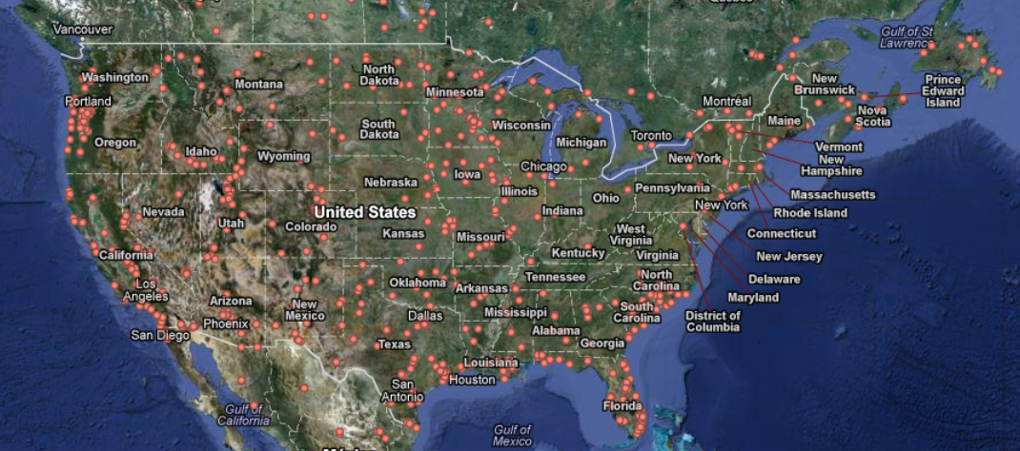
Example
Weather sensors spread over the US
Skyline of states with the most extreme weather situations
  Lowest temperature, highest humidity
  Lowest temperature, lowest dew-point (dew-point=f(temperature, humidity))
  Average values over all sensors at each state

Slide 4
Challenges
Distributed data
  Data points are fragmented → cannot apply distributed skyline techniques
  Non-linear functions
    Direction of the local update not the same as direction of the change in the skyline space
    Impossible to filter out local updates
Network cost
  Prohibitive for voluminous streams
    Financial streams - stock ticks (80 Million updates per second)
    Network packet monitoring (up to 100Gbps)
    Sensors (arbitrary frequency)

Slide 5
Our Contribution
First work to address continuous fragmented functional skyline monitoring
Decompose skyline monitoring to a set of threshold crossing queries
  Monitor using the Geometric Method
  Minimize the number of queries
Novel adaptive combination of streaming/geometric scheme
  Stochastic model
  Observes the sites behavior
  Switches to the most efficient monitoring scheme

Slide 6
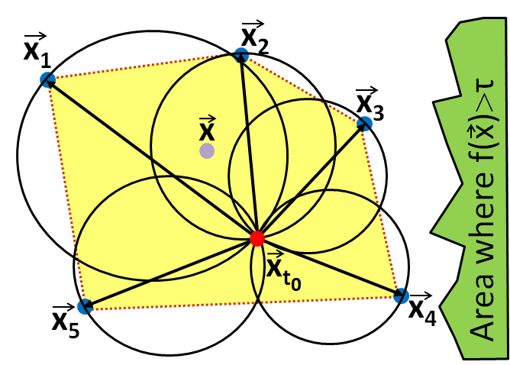
Geometry to the rescue
The geometric method [SIGMOD06, TODS07]
  Distributed monitoring of threshold crossing queries with fragmented data
  Detect when where is the aggregate value, for arbitrary
Key idea: Cannot monitor the range → monitor domain
Any convex aggregate is
within the balls with
center
and radius
Check if
for all in all balls
Drift of x at node i
Current average of x
Unknown
Last known average

Slide 7
Monitoring of fragmented skylines
Decompose skyline monitoring to threshold queries
  PIVOT: Check relative positioning of each object to fixed pivot points
    Pivot points defined in range space
  DIRECT: Check relative positioning of each pair of objects in range space
Average values e.g., avg #packets, tr.vol. per IP address
PIVOT
f(.)
DIRECT

Slide 8
The PIVOT method
Check relative positioning of each object to fixed pivot points
  Pivot points – mid points between two objects in f() space
  Geometric method to determine threshold crossings
Example: function vector f: R²→R²
Average values e.g., avg #packets, tr.vol. per IP address
f(.)

Slide 9
The PIVOT method
Check relative positioning of each object to fixed pivot points
  Pivot points – mid points between two objects in f() space
  Geometric method to determine threshold crossings
Example: function vector f: R²→R²
Average values e.g., avg #packets, tr.vol. per IP address
f(.)

Slide 10
The PIVOT method
Handling of threshold crossings
  Synchronization: Collect updated statistics for violating object
    Partial: updates at some nodes cancel out → partial average not causing threshold crossings
    Full: recompute skyline and update threshold queries
Full algorithm
  Initialization: collect statistics and compute initial skyline
  Extract threshold queries and broadcast to nodes
  Threshold crossing → initiate synchronization process.

Slide 11
The DIRECT method
Check relative positioning of each pair of objects
  No fixed pivot points → possibly more slack for movement
  Threshold queries constructed on pairs of objects
    g(o₁|o₂)=f(o₁)-f(o₂) -- dimensions of function double
    Threshold crossing when sign of g(o₁|o₂)[.] changes
Example with 1-dim. objects:
g(.)

Slide 12
Reducing the number of queries
Example for PIVOT
  Group pivot points
    p_{1,5} and p_{1,6} grouped to p_{1,G}
  Keep most restricting pivot points
    p_{1,5}, p_{1,6}, p_{1,G} dominated by p_{1,4}
Total queries reduced to O(n)
Same principles apply for DIRECT
  Composite objects

Slide 13
Adaptive method: Streaming vs Geometric
Only for PIVOT
  Some queries are just too tight → frequent threshold crossings
    Frequent synchronization more expensive than streaming
    Identify these queries and set the corresponding objects to streaming mode
      Cost model based on random walks and statistics
      Adaptively switches between streaming and geometric scheme
Cannot be used in DIRECT
  Objects always examined in pairs

Slide 14
Experimental evaluation
Baseline: All updates streamed to a coordinator
Measure network efficiency
  Transfer volume and number of messages
  Accuracy always 100%
Data sets: Real-world and synthetic
  Up to 94 Million updates, 5000 sites, 10000 objects
Functions used:
  Identity:
  Variance:
  Euclidean norm:
  L2 distance in 4 dimensions:

Slide 15
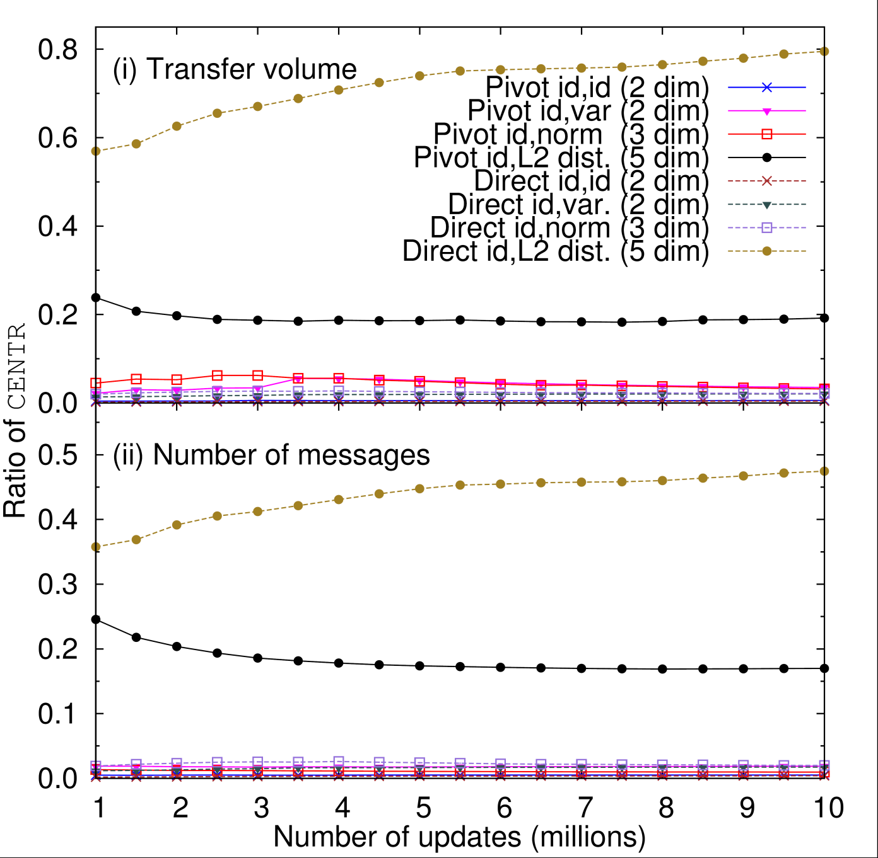
Synthetic data sets
Cost presented as ratio of baseline
2 - 5 dimensions at domain space
2 functions
  Identity
  Variance
  Euclidean norm
  L2 distance

Slide 16
Conclusions
First work of Continuous Fragmented Skylines
  Objects are fragmented over the network
  Skyline dimensions defined through arbitrary functions
  Continuous maintenance
PIVOT and DIRECT
  Decomposition of fragmented skyline maintenance to threshold crossing queries
  Use of Geometric Method to monitor these queries
  Optimizations
    Reduction of queries to O(n)
    Adaptive monitoring based on novel cost model
Scalable and efficient
  Orders of magnitude network improvement compared to streaming

Slide 17


Thank you for your attention
Questions?
Work partially supported by:
LIFT: USING LOCAL INFERENCE
IN MASSIVELY DISTRIBUTED SYSTEMS
http://www.lift-eu.org/

Slide 18
Skylines 101
Buying a used car
  It should be cheap
  But it should not be too old
  And ...
Let the user decide on the trade-off of cheap and not too old
worst
high
price
low
best
low
high
age
Notes:
Introduction to skylines

Slide 19
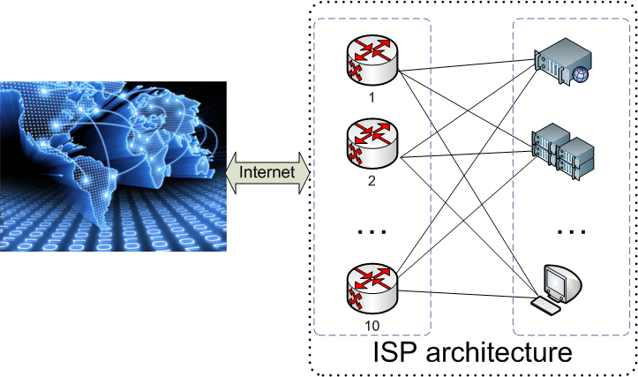
Example
Network monitoring at the edge routers
Raw data
router | target IP | #packets | vol.
1 | 121.11.*.* | 134 | 1226
1 | 110.1.*.* | 60 | 72
2 | 121.11.*.* | 180 | 1280
2 | 110.1.*.* | 80 | 100
3 | 121.11.*.* | 160 | 1301
4 | 201.7.*.* | 627 | 4874
… | … | … | …
Dimensions
target IP | #packets | vol. | var(vol.)
121.11.*.* | 158 | 1269 | 1269
110.1.*.* | 70 | 86 | 86
201.7.*.* | 627 | 4874 | 4874
117.3.*.* | 884 | 982 | 982
… | … | … | …
DoS attack
P2P
DDoS attack
Tr.vol.
DDoS attack
Var(Tr.vol.)
#packets
#packets
Notes:
Another motivation example…

Slide 20
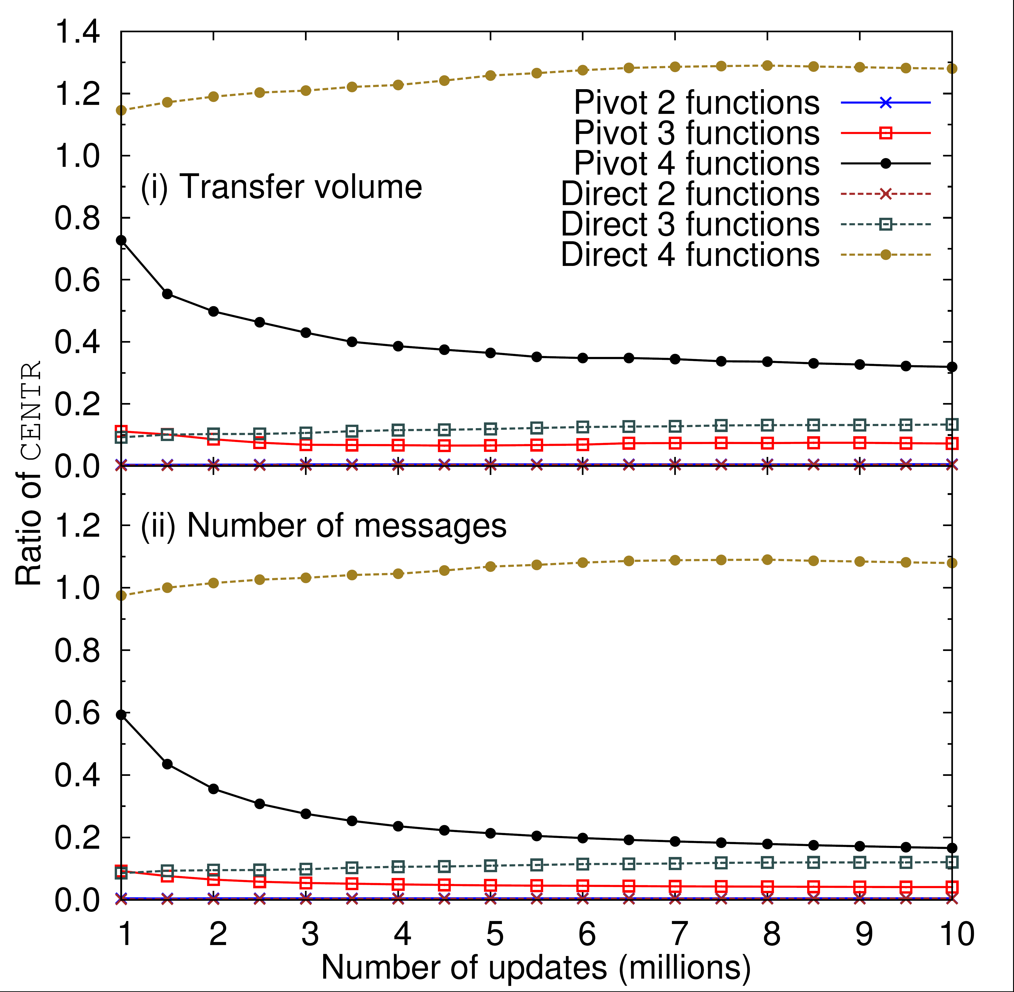
Synthetic data sets
1000 sites
2000 objects
10 Million updates
2-4 functions
Notes:
Further experiments

Slide 21
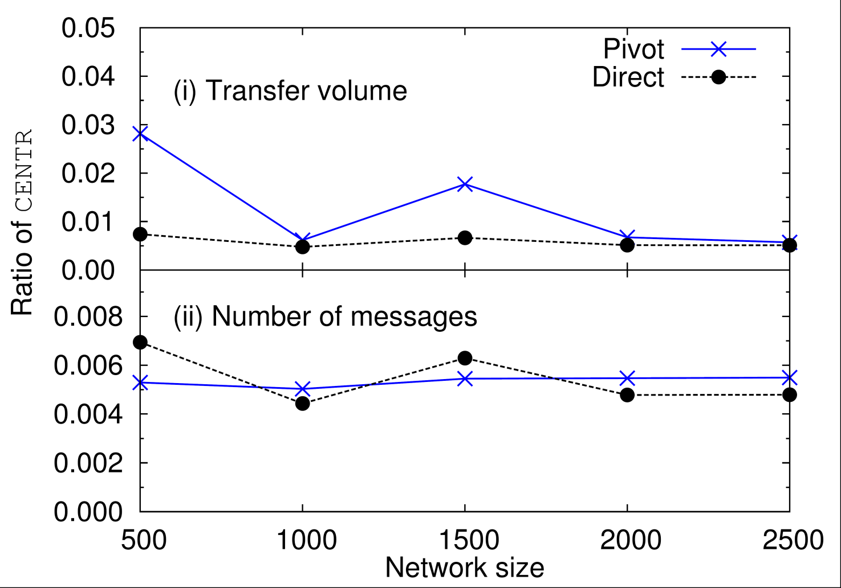
Synthetic data sets
2000 objects
10000 updates per site/object
2 dimensions
Notes:
Further experiments

Slide 22
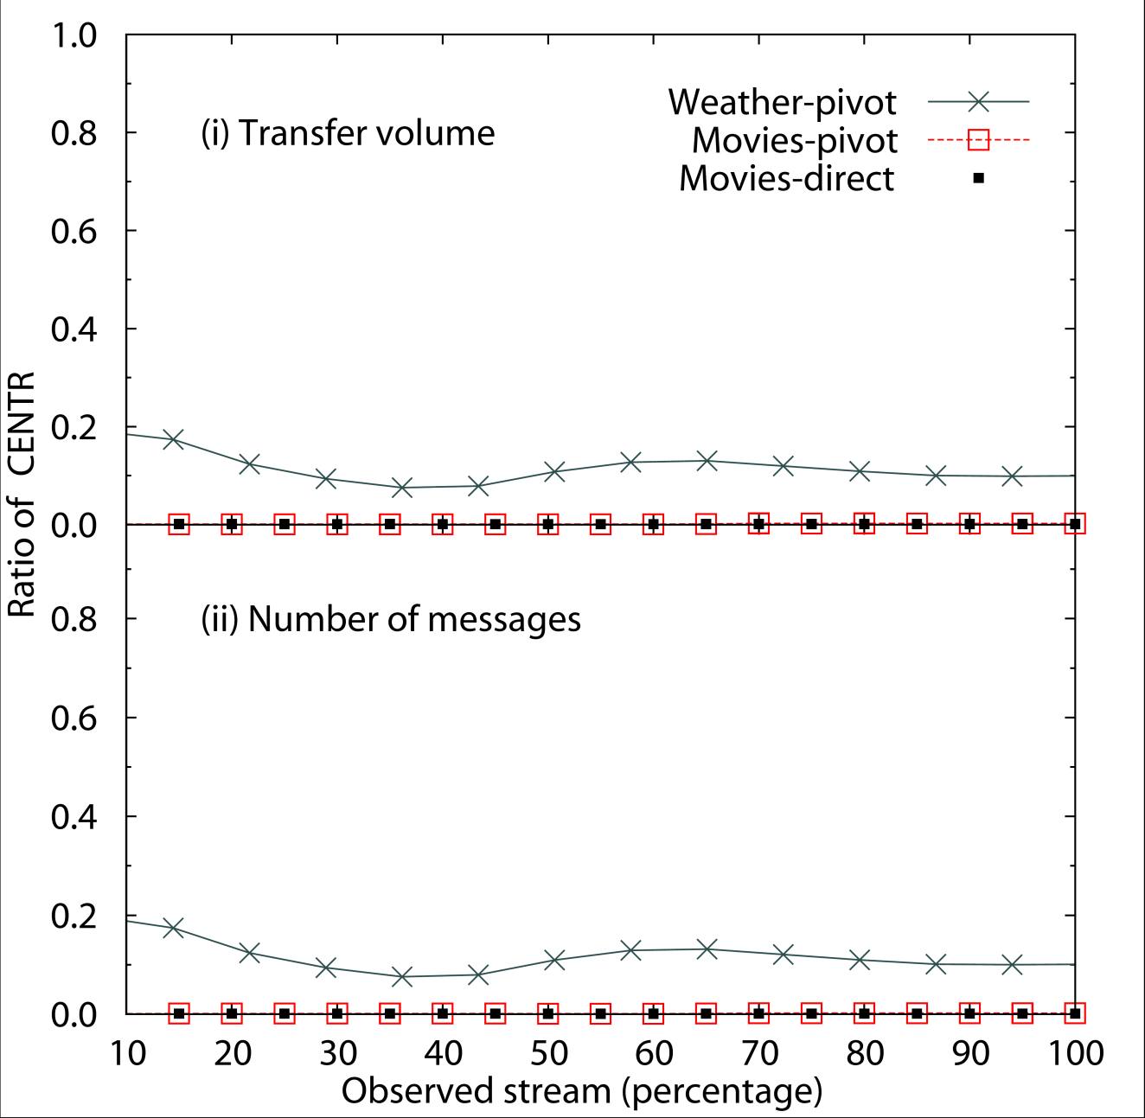
Real world data sets
Weather: NOAA weather data (2010-2011)
  ~94 million readings
  5423 sensors, 257 countries
  Sensors monitor only one object!
Movies: Movielens movie ratings
  10 million ratings
  10681 movies
  71567 users assigned to 200 sites
Winter 2010/11
Notes:
Further experiments

