Slide 1
Approximate algorithms for efficient indexing, clustering, and classification in Peer-to-peer networks
Odysseas Papapetrou
^{18 April 2011}
L3S Research Center, University of Hannover, Germany

Slide 2
Introduction
Application scenarios of Peer-to-peer
  File sharing, IP telephony, video streaming, data analysis, collaborative spam filtering, …
Frequent building blocks
  Information retrieval
  Data mining
Challenges
  Large networks
  High churn
  High network cost

Slide 3
Introduction
Information retrieval and data mining in P2P networks
  Information retrieval
    Maintaining an inverted index for keyword search
    Near-duplicate detection
  Data mining
    Clustering over a P2P network
    Classification over a P2P network

Slide 4
Outline
  Introduction
  PCIR: Maintaining the inverted index for keyword search
    Related work
    Basic PCIR
    Clustering-enhanced PCIR
    Experimental evaluation
  PCP2P: P2P text clustering
    Related work
    PCP2P
    Experimental evaluation
  Brief summary
    POND: P2P near duplicate detection
    CSVM: P2P classification
  Conclusions

Slide 5
Information retrieval over P2P
The P2P information retrieval model
Thousands of nodes, constantly changing!
  Standard users
  Digital libraries
No central server!
Google-style search
12 days of christmas.mp3
christmas carol.mp3
athens.png
chania.png
crete.png
winter hannover.png
football.txt
tennis.txt
basket.doc
…
beautiful mind.avi
recipes.doc
the king speech.mpeg
les miserables.doc
recipes.pdf

Slide 6
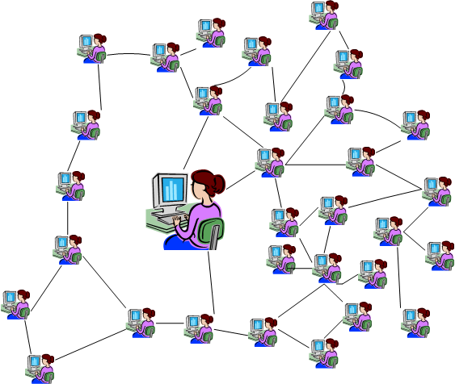
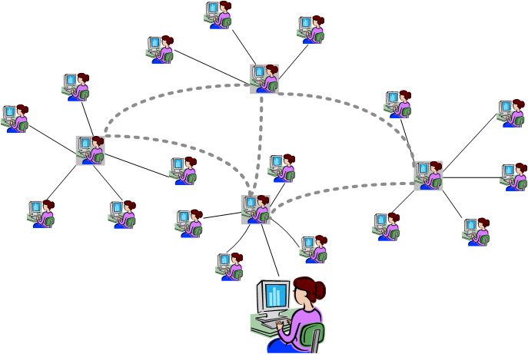
Unstructured P2P networks
  Peers form a connected graph
  Query flooding with a time-to-live
  Synopses: Gnutella-QRP[Gnu], EDBFs [Infocom05],PlanetP [HPDC]
  Super peers: Gnutella 0.6, FastTrack [ComNet06], [ICDE03], [WWW03]
  Scalability to large networks and quality of results
  Rodrigues and Druschel: ‘Good at finding hay, but bad at finding
  needles’ [CACM10]

Slide 7
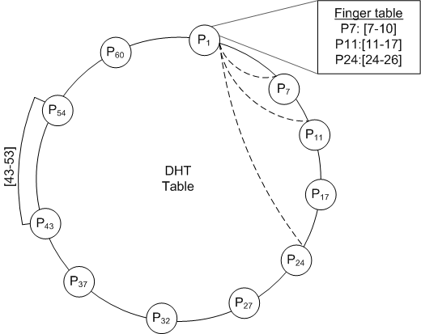
Structured P2P over DHT
Distributed Hash Tables (DHTs)
  Functionality of a hash table: put(key, value)and get(key) – similar to centralized hash tables
  Chord: Peers organized in a ring structure
  Finger tables
  Peers establish links to
  peers with
  Similar to binary search →
  Log(n) messages per
  DHT lookup

Slide 8
Structured P2P over DHT
Term | Peer | Term freq. in peer
Football | Peer 13 Peer 6 Peer 11 ... | 20 17 13 ….
Chocolate | Peer 84 .... | ….
... | …. | ….
List of relevant peers for each term
DHT key
DHT value
State of the art vary in index granularity:
  Minerva
  Alvis
  sk-Stat, mk-Stat
  …

Slide 9
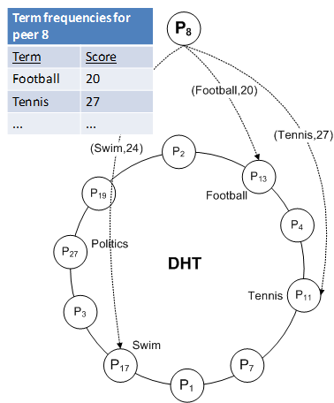
IR and P2P
  DHT publishing steps
  Each peer extracts the frequencies for all its terms
  Each peer publishes its scores in the DHT inverted index
    One DHT lookup for each of its terms - log(n) messages
  Periodic execution

Slide 10
Structured P2P over DHT
DHT-based indexes for distributed search
  O(log(n)) per term lookup per peer →
  Total publishing cost:
  5000 peers, 1000 terms per peer: 61 million msgs
How to reduce the network cost
  Key insight: Some terms are very popular across peers! Can we exploit this to reduce the indexing cost?

Slide 11
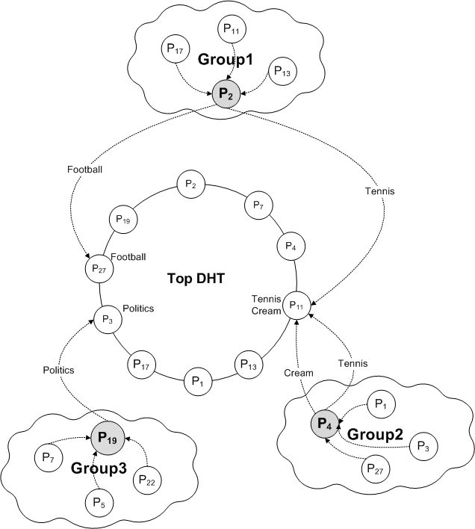
PCIR: Peer Clusters for Inf. Retrieval
Basic approach
All peers are part of the global DHT
Peers also form groups
Each peer submits its index to its super-peer
Super-peers perform:
  DHT lookups
  DHT updates
  for all distinct group terms

Slide 12
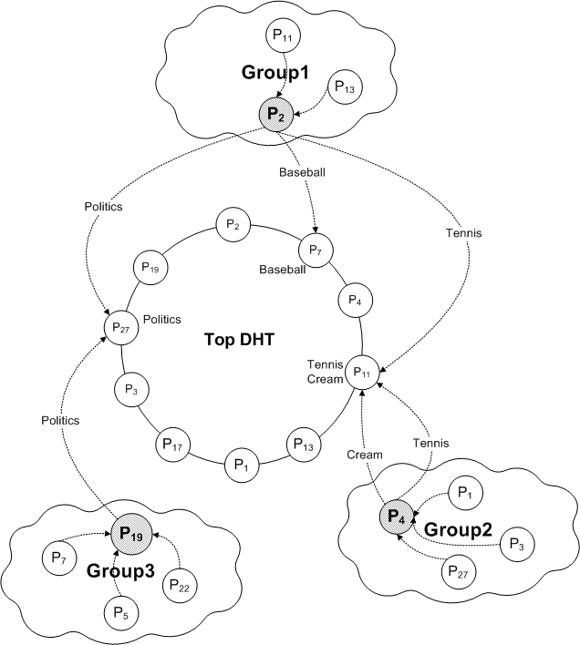
Updating the super-peers
Step 1: Peer joins a group, or creates a group itself
Prob[newGroup]=0.1
  Used to determine the ratio of peers/super-peers

Slide 13
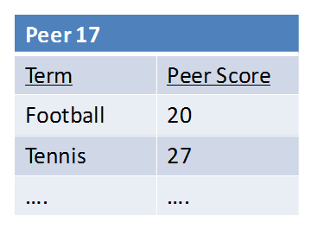

Updating the super-peers
Step 2: Peers submit their terms to the group’s super peer
  No DHT lookup required
Peer 17
Term | Peer Score
Football | 20
Tennis | 27
…. | ….

Slide 14
Updating the DHT
Term | Peer | Peer Score
Football | Peer 17 Peer 13 | 20 17
Step 3: Super peer publishes the group’s terms to the DHT
  Exploits term overlap!
  1 DHT lookup per term per group
Term | Peer | Peer Score
Football | Peer 17 Peer 13 | 20 17
Tennis | …. | ….
…. | …. | ….

Slide 15
Updating the DHT
Term | Peer | Peer Score
Tennis | Peer 17 Peer 13 | 19 16
Step 3: Super peer publishes the group’s terms to the DHT
  Exploits term overlap!
  1 DHT lookup per term per group
Term | Peer | Peer Score
Football | Peer 17 Peer 13 | 20 17
Tennis | …. | ….
…. | …. | ….

Slide 16
PCIR algorithm
Steps
  Peer joins a group or forms its own
  Peer submits its terms at the super peer of its group
  Super peer publishes the group’s data to the DHT
Steps 2-3 repeated periodically to compensate churn
Result: a superset of the SOTA inverted index – no information loss → Query execution as in the SOTA!
Term | Peer | Peer Score | Super peer
Football | Peer 17 Peer 35 Peer 13 …. | 20 17 17 …. | Peer 2 Peer 21 Peer 2 ….
Tennis | …. | …. | ….

Slide 17


How many super-peers?
Tradeoff
      maximum overlap less overlap
      super-peer gets overloaded low workload at super-peers
      not a P2P solution anymore
  Balance the super peer workload and term overlap
    User sets an acceptable load per super-peer
      Maximum network cost
      Analysis relying on network statistics → number of super-peers
    Still high overlap
1 super-peer only
many super-peers

Slide 18
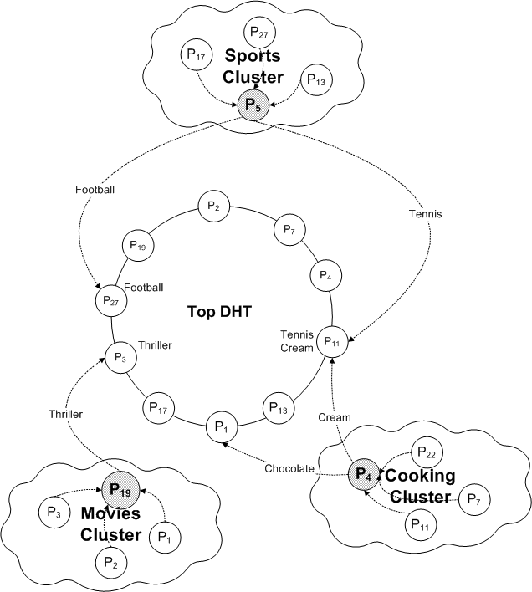
Clustering-enhanced PCIR
Clustering-enhanced PCIR
Cluster peers around similar peers to increase term overlap
  Larger term overlap →
  fewer distinct terms per cluster →
  even fewer DHT lookups

Slide 19
How to cluster the peers
Clustering a peer:
  Peers and super-peers: term sets→ Bloom filters
  Peer selects the most promising super peers using the DHT, and sends its Bloom filter to them
  Probabilistic guarantees that the peer joins the best cluster
BF_{sp1}
0
1
0
1
1
0
…
0
0 | 1 | 1 | 0 | 1 | 0 | … | 1
BF_{sp2}
0 | 1 | 1 | 0 | 1 | 0 | … | 1
BF_{p}
BF_{sp3}
0 | 1 | 1 | 0 | 1 | 0 | … | 1
BF_{sp4}
0 | 1 | 1 | 0 | 1 | 0 | … | 1

Slide 20
Evaluation
Measures
  Average messages per peer
  Average transfer volume per peer
  More results in the thesis
Datasets
  Reuters Corpus Volume 1, 160,000 articles
  Medline, 100,000 abstracts
Comparisons
  Flat DHT indexing (e.g., Minerva, Alvis, mk-Stat, sk-Stat)
  Basic PCIR
  Clustering-enhanced PCIR

Slide 21
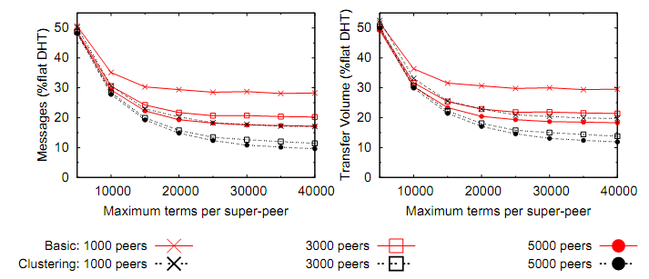
Network cost Vs super-peer workload
Baseline (100%): Minerva – peer granularity index

Slide 22
Network cost at super peers

Slide 23
PCIR: Indexing for keyword search
Conclusions
  Basic and clustering-enhanced PCIR
  Exploit term overlap across peers
  Maintains the same inverted index as SOTA approaches
  No peer gets overloaded
  Odysseas Papapetrou, Wolf Siberski, Wolfgang Nejdl: PCIR: Combining DHTs and peer clusters for efficient full-text P2P indexing. Computer Networks 54(12): 2019-2040 (2010)
  Odysseas Papapetrou, Wolf Siberski, Wolfgang Nejdl: Cardinality estimation and dynamic length adaptation for Bloom filters. Distributed and Parallel Databases 28(2): 119-156 (2010)
  Odysseas Papapetrou. Full-text Indexing and Information Retrieval in P2P systems, in: Proc. Extending Database Technology PhD Workshop (EDBT), 2008, Nantes, France.
  Odysseas Papapetrou, Wolf Siberski, Wolf-Tilo Balke, Wolfgang Nejdl. DHTs over Peer Clusters for Distributed Information Retrieval, in: Proc. IEEE 21st International Conference on Advanced Information Networking and Applications (AINA), 2007, Niagara Falls, Canada.

Slide 24
P2P text clustering
Clustering of documents without a central server
  Important data mining technique
  Useful for information retrieval
  Challenging because of network size, and high dimensionality of documents and cluster centroids!

Slide 25
Related work
  LSP2P [TKDE09]
    Unstructured P2P network
    Peers gossip their centroids
    Algorithm repeats until convergence
    Assumption: Peers have documents from all classes!

Slide 26
Related work
  HP2PC [TKDE08]
    Peers organized in a hierarchy
    Each level divided into neighborhoods
    Super-peers at each neighborhood
Root
...
...
...
...
...
...
...

Slide 27
Related work
  KMeans
  Initialize k random cluster centroids
  Assign each document to nearest cluster
  Repeat until convergence
Example in two dimensions
o
o
o
C
o
o
o
dimension 2
o
o
o
o
o
o
o
o
o
o
C
o
o
o
o
o
o
o
dimension 1

Slide 28
Related work
  KMeans
  Initialize k random cluster centroids
  Assign each document to nearest cluster
  Repeat until convergence
Example in two dimensions
o
cosine=0.5
C
o
o
o
o
o
cosine=0.8
o
o
o
dimension 2
o
o
o
o
o
o
o
C
o
o
o
o
o
o
o
dimension 1

Slide 29
Related work
  KMeans
  Initialize k random cluster centroids
  Assign each document to nearest cluster
  Repeat until convergence
Example in two dimensions
o
cosine=0.5
C
o
o
o
o
o
cosine=0.8
o
o
o
dimension 2
o
o
o
o
o
o
o
C
o
o
o
o
o
o
o
dimension 1

Slide 30
Related work
  KMeans
  Initialize k random cluster centroids
  Assign each document to nearest cluster
  Repeat until convergence
Example in two dimensions
o
o
o
C
o
o
o
dimension 2
o
C
o
o
o
o
o
C
C
o
o
o
o
o
o
o
o
o
o
o
dimension 1

Slide 31
Distributing K-Means
DKMeans: An unoptimized distributed K-Means
  Assign maintenance of each cluster to one peer: Cluster holders
  Peer P1 wants to cluster its document d
    Send d to all cluster holders
    Cluster holders compute cosine(d,c)
    P1 assigns d to cluster with max. cosine, and notifies the cluster holder
Problem
    Each document sent to all cluster holders
    Network cost: O(|docs| × k)
    Cluster holders get overloaded
P1
Cluster holder for
cluster 1
send d
cos(d,c₁)
P2
P8
P3
P4
P9
P6
Cluster holder for
cluster 2
P7
P5

Slide 32
PCP2P: Probabilistic Clustering over P2P
  PCP2P: Approximation to reduce the network and computational cost…
  Compare each document only with the most promising clusters
  Pre-filtering step: Find candidate clusters for a document using an inverted index
  Full comparison step: Use compact cluster summaries to exclude more candidate clusters

Slide 33
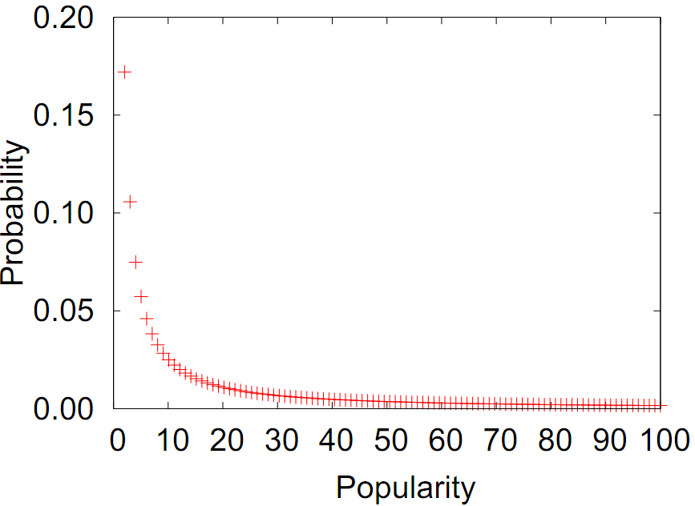
PCP2P: Probabilistic Clustering over P2P
Approximation to reduce the network and computational cost…
  Compare each document only with the most promising clusters
  Key insight:
    Probabilistic topic models →A cluster and a document about the same topic will share some of the most frequent topic terms, e.g., Topic “Economy”: crisis, shares, financial, market, …
    Estimate these terms, and use them as rendezvous terms between the documents and the clusters of each topic
crisis
Probab. topic model
Topic: Economy
shares
market

Slide 34
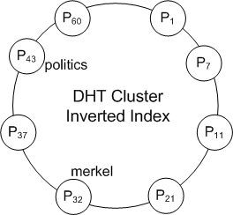
PCP2P: Probabilistic Clustering over P2P
  Identifying the rendezvous terms
  Frequent cluster/document terms: term freq. > thres₁ / thres₂
  Clusters index their summaries at all terms with TF > thres₁
    Cluster summary: <Cluster holder IP address, frequent cluster terms, length>
    E.g. <132.11.23.32, (politics,157),(merkel,149), 3211>
thres₁ = 140
Centroid for Cluster 1
Term | Frequency
politics | 157
merkel | 149
obama | 121
sarkozy | 110
world | 98
... | ...
Add to “politics” summary(cluster1)
Add to “merkel” summary(cluster1)

Slide 35
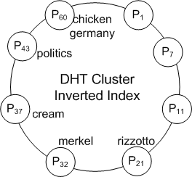
Pre-filtering step
Approximation to reduce the network cost…
  Pre-filtering step: Efficiently locate the most promising centroids from the DHT and the rendezvous terms
    Lookup most frequent terms only → candidate clusters
    Send d to only these clusters for comparing
    Assign d to the most similar cluster
New document
Term | Frequency
politics | 14
germany | 13
merkel | 11
sarkozy | 7
france | 6
... | ...
Which clusters published “politics”
Which clusters published “germany”
thres₂ = 12
cluster1: summary
cluster7: summary
cluster4: summary
Candidate Clusters
cluster1
cluster7
→ Cos: 0.3
→ Cos: 0.2
→ Cos: 0.4
cluster4

Slide 36
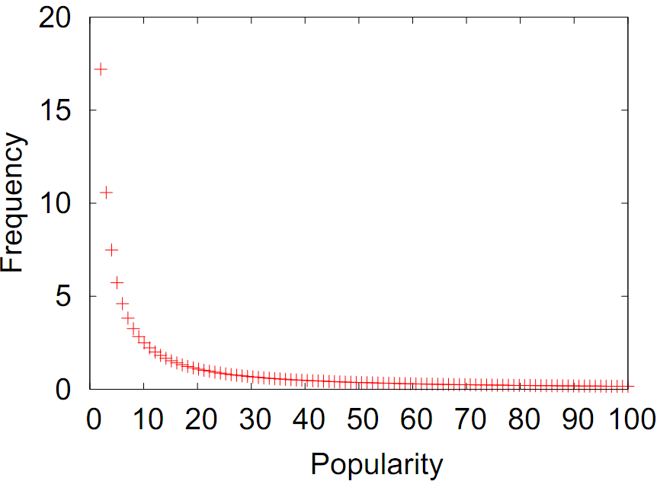
Pre-filtering step
Probabilistic guarantees
  User selects correctness probability Pr_{pre}→cost/quality tradeoff
  Cluster holders/peers determine the frequent term thresholds per cluster/document (thres₁ and thres₂)
  The optimal cluster will be included in with probability > Pr_{pre}
  Key idea: Probabilistic topic models + Chernoff bounds to get the probability that a term will not be published
crisis
Probab. topic model
Topic: Economy
Cluster or document
Topic: Economy
shares
Error when:
Pr[tf(crisis)<4 | doc Economy]
(for all top terms)
market

Slide 37
Full comparison step
Full comparison step
  Use the summaries collected from the DHT to estimate the cosine similarity for all clusters in
  Use estimations to filter out unpromising clusters → Send d only to the remaining
Three strategies to estimate cosine similarity
  Conservative: upper bound → always correct
  Zipf-based and Poisson-based
    Assumptions about the term distribution → small error probability
  Poisson-based PCP2P
    Tight probabilistic guarantees
    Enables fine-tuning of cost/quality ratio

Slide 38
Evaluation
Evaluation objectives
  Clustering quality
  Network efficiency
  Document collections
    Reuters, Medline (100,000 documents)
    Synthetic created using generative topic models
  More results in the thesis
Baselines
  DKMeans: Baseline distributed K-Means
  LSP2P: State-of-the-art in P2P clustering based on gossiping

Slide 39
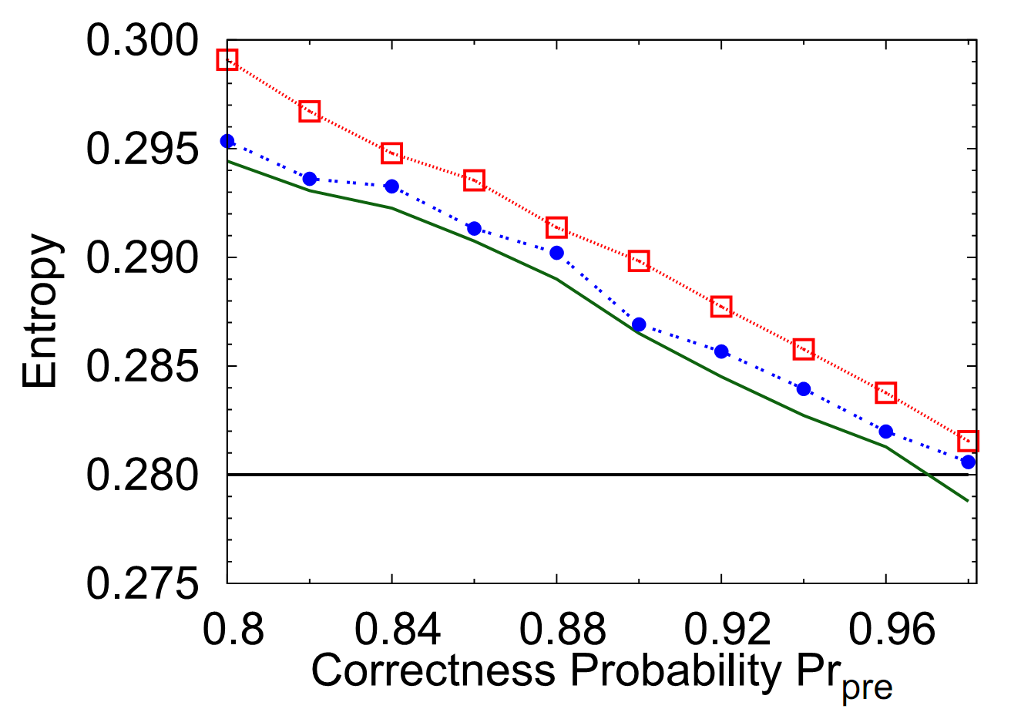
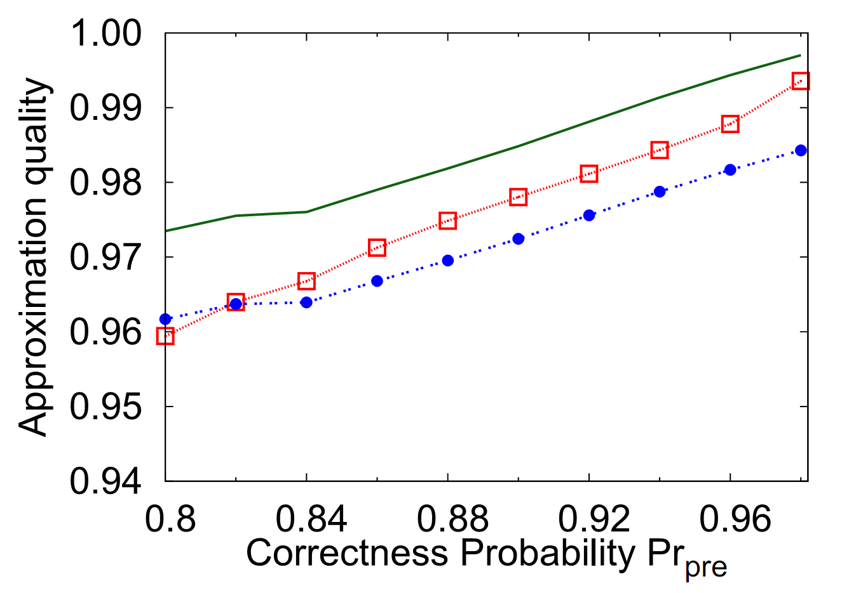
Evaluation – Clustering quality
  Increasing desired probabilistic guarantees improves quality
  Correctness probability always satisfied
  LSP2P very bad at high-dimensional datasets
More results in the thesis:
  Quality independent of network and dataset size
  Independent of #clusters and collection characteristics

Slide 40
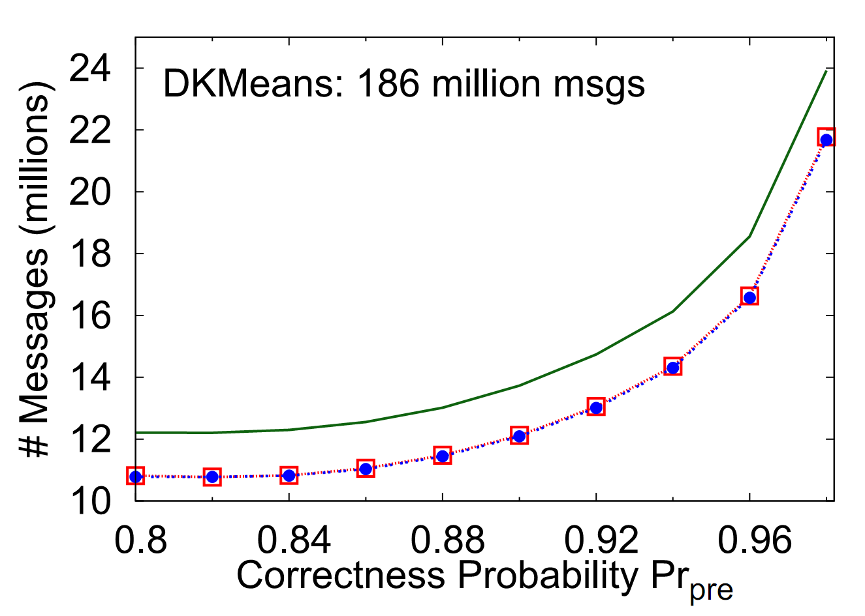
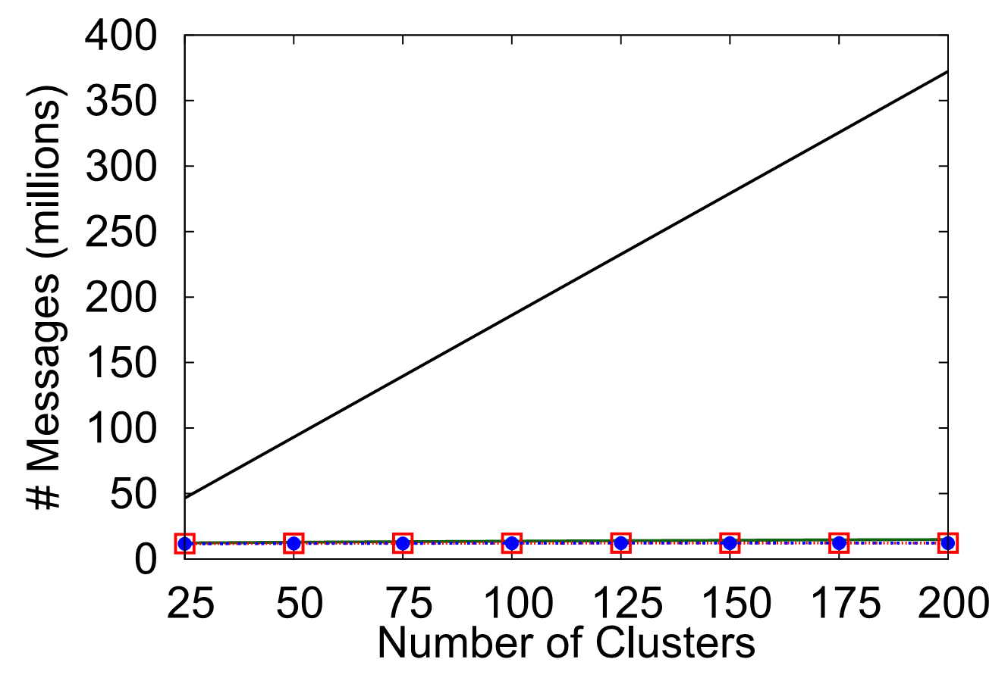
Evaluation – Network cost
  At least an order of magnitude less cost than baseline
  Efficiency: Poisson ~ Zipf > Conservative >> DKMeans
  Performance gains increase with number of clusters

Slide 41
P2P text clustering
Conclusions
  Probabilistic text clustering over P2P networks using probabilistic topic models
  Pre-filtering step relying on inverted index
  Full comparison step: Conservative, Zipf-based, Poisson-based
  Odysseas Papapetrou, Wolf Siberski, Norbert Fuhr. Text Clustering for Peer-to-Peer Networks with Probabilistic Guarantees, in: Proc. ECIR 2010.
  Odysseas Papapetrou. Full-text Indexing and Information Retrieval in P2P systems, in: Proc. EDBT PhD workshop 2008.
  Odysseas Papapetrou, Wolf Siberski, Fabian Leitritz, Wolfgang Nejdl. Exploiting Distribution Skew for Scalable P2P Text Clustering Databases, in: Proc. DBISP2P 2008.
  Odysseas Papapetrou, Wolf Siberski, Norbert Fuhr. Decentralized Probabilistic Text Clustering, under revision at TKDE, 2010.

Slide 42
Additional work in the thesis…
POND: Efficient and effective near duplicate detection in P2P networks with probabilistic guarantees (P2P 2010:1-10)
  Locality Sensitive Hashing for NDD of multimedia and text files
  POND: Finding the most efficient configuration to satisfy the probabilistic guarantees
CSVM: Collaborative classification in P2P networks (WWW (Companion Volume) 2011: 97-98, extended version under submission)
  Dimensionality reduction
  Share classifiers to construct meta-classifiers
  Avoids privacy issues
  Closely approximates the centralized case without centralization

Slide 43
Future work
PCIR and PCP2P extensions
  Consider difference in update rate: Some information is more ‘static’ than other
Apply the clustering core idea to different scenarios
  Index-based clustering for streaming data
  Other clustering algorithms and other similarity measures
Bloom filter extensions for different scenarios, e.g., sensor networks
  A good synopsis is always useful

Slide 44
References
  [Gnu] I. J. Taylor. “Gnutella”. In From P2P to Web Services and Grids, Computer Communications and Networks, pages 101–116. Springer London, 2005
  [Infocom05] A. Kumar, J. Xu, E. Zegura. “Efficient and scalable query routing for unstructured peer-to-peer networks”. INFOCOM’05
  [HPDC] F. M. Cuenca-Acuna, C. Peery, R. P. Martin, and T. D. Nguyen. “PlanetP: Using gossiping to build content addressable peer-to-peer information sharing communities”. HPDC’03
  [ComNet06] J. Liang, R. Kumar, and K. W. Ross. The fasttrack overlay: A measurement study. Computer Networks, 50(6):842 – 858, 2006.
  [ICDE03] B. Yang, H. Garcia-Molina, "Designing a Super-Peer Network," ICDE'03
  [WWW03] W. Nejdl et al. Super-peer-based routing and clustering strategies for rdf-based peer-to-peer networks. WWW 2003.
  [CACM10] R. Rodrigues and P. Druschel. Peer-to-peer systems. Commun. ACM, 53(10):72–82, 2010.

Slide 45
Support slides

Slide 46
Presented papers
  Journals
    Computer Networks
    Distributed and Parallel Databases
    TKDE (in communication)
  Papers
    WWW’11 poster
    ECIR’10
    P2P’10
    DBISP2P’08
    EDBT PhD workshop 2008
    AINA 2007
  Total published
    3 journals
    19 peer-reviewed conferences
    2 peer-reviewed workshops

Slide 47
Why P2P research is important
Some solutions just scale better and are cheaper when done in P2P
  video streaming, telephony, search on distributed data
P2P results can be directly applied in different problems
  Apache Hadoop: Builds on location-based optimization for assigning jobs: Execute the job next to the data. Combines key ideas from P2P and mobile agents
  Amazon Dynamo: A key-value store, inheriting the key concept of DHTs
  Reliability, robustness, reputation: Widely considered in P2P networks
  Ad-hoc collaboration and distributed computing: Einstein@home, SETI@home, ...
  Query optimization for distributed databases and P2P

Slide 48
PCIR

Slide 49
Super-peers
A
A
Q
Q
Q
Q
  Peers send summaries to super-peers
  Super-peers form a connected graph
  Peer broadcasts query to super-peers, with a TTL
  e.g., Gnutella 0.6, FastTrack [ComNet06], [ICDE03], [WWW03]
  Does not scale to large networks

Slide 50
Gossip-based
A
Q
Q
Q
Q
Q
Q
Q
Q
Q
Q
A
Q
Q
  Peers form a connected graph
  Query flooding with a time-to-live
  Top-k results returned following the same path
  E.g. Gnutella, Gnutella-QRP[Gnu], EDBFs [Infocom05],PlanetP [HPDC]
  Does not scale to large networks

Slide 51

Using a Distributed Inverted Index
The Inverted Index approach
Query execution:
  Lookup query terms in inverted index
  Merge results
  Compute similarity (e.g., cosine, jaccard)
  Return top relevant documents
Term | Document | tf
Football | c:\data\sports.txt c:\data\football.txt c:\data\feb\sports-Feb.txt ... | 20 17 13 ….
Chocolate | c:\documents\recipes.txt .... | ….
... | …. | ….
Bag of words model
Term | Term Freq. (tf)
football | 20
tennis | 17
… | …

Slide 52
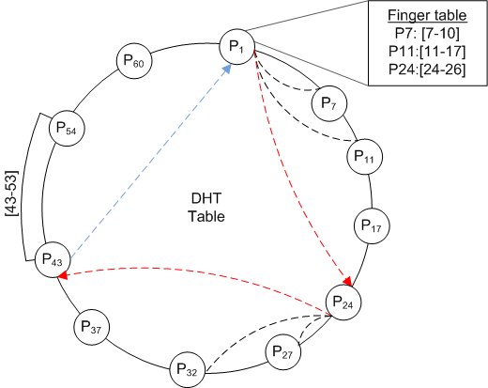
Structured P2P over DHT
Distributed Hash Tables (DHTs)
  DHT Lookup: Find the peer responsible for a key
  Cost: O(Log(n)), where n: #peers
  Example: P₁ executes get(key=47)
    P1 → P24 → P43
    Similar to binary search
  Hashing for non-numeric keys:
  md5hash(football) → number

Slide 53
Structured P2P over DHT
State of the art: Minerva, Alvis, sk-Stat, mk-Stat,…
  Vary granularity of index: document, peer, adaptive…
  Vary score: tf, tf-idf, …
  Vary keys: all/some terms, pairs of terms, …
DHT key
DHT value
Term | Peer | Term freq. in peer
Football | Peer 13 Peer 6 Peer 11 ... | 20 17 13 ….
Chocolate | Peer 84 .... | ….
... | …. | ….
List of relevant peers for each term

Slide 54
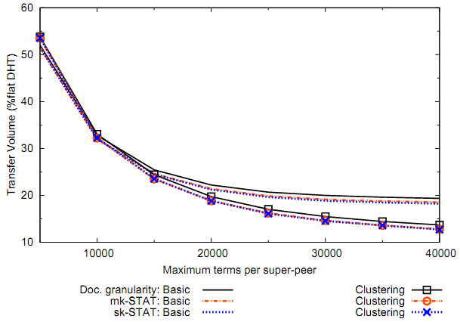
Applying PCIR to different systems

Slide 55
PCP2P

Slide 56
Full comparison step
  Estimate cosine similarity ECos(d,c), for all c in
  Send d to the cluster with maximum ECos,
  Remove all clusters with ECos< Cos(d, )
  Repeat until is empty
  Assign to the best cluster
New document
Term | Frequency
politics | 14
germany | 13
merkel | 11
sarkozy | 7
france | 6
... | ...
Candidate Clusters in
add
cluster1
cluster7
cluster4
Cos:0.38
cluster1: ECos:0.4
cluster7: ECos:0.2
cluster4: ECos:0.5
Cos:0.37
?

Slide 57
Full comparison step
  Three strategies to compute ECos
    Conservative
      Compute an upper bound → always correct
    Zipf-based and Poisson-based
      Assumptions about the term distribution
      Introduce small error probabilities
    Poisson-based PCP2P:
      Tight probabilistic guarantees
      Enables fine-tuning of cost/quality ratio
  Details offline or in the paper…

Slide 58
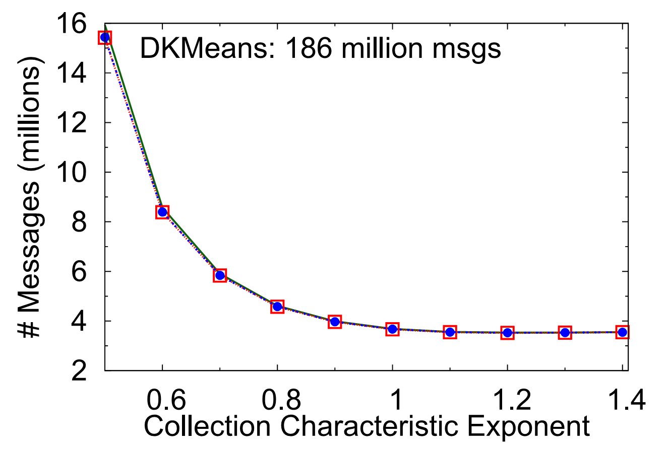

Evaluation – Network cost
  Text collections follow Zipf distribution
  Efficiency of PCP2P increases with the collection characteristic exponent (usually )

